Slide 1



K&O Personnel Management Systems
Created by: Jon King, Anthony Orengo

Slide 2


Team
Jon King
Anthony Orengo

Slide 3
About K&O
K&O Personnel Management System is a web-based application development team.

Slide 4
The K&O Mission
Create secure and reliable personnel management systems for all organizations worldwide.

Slide 5
Problem
Personnel Management
Employee Status
Time Worked

Slide 6
Solution
A secure and reliable barcode scanning management systems allowing organizations to track employee statuses by granting leaders access to databases that would store their employees and allow bosses to access this information from anywhere in the world.

Slide 7


Technologies Used

Slide 8

Technologies Used
Hardware Technologies
Software Technologies
Coding Languages
Laptop with suitable ports
Realinn RL6200 Barcode Scanner
Wireless Keypad
Apache Netbeans IDE
SQL Plus
Free MySQL Hosting
AWS(Elastic Beanstalk/Route 53)
Maria DB
Paint 3D
PowerPoint
Adobe Photoshop
Free Logo Design
Java
JSP
JavaScript
HTML
CSS
SQL

Slide 9
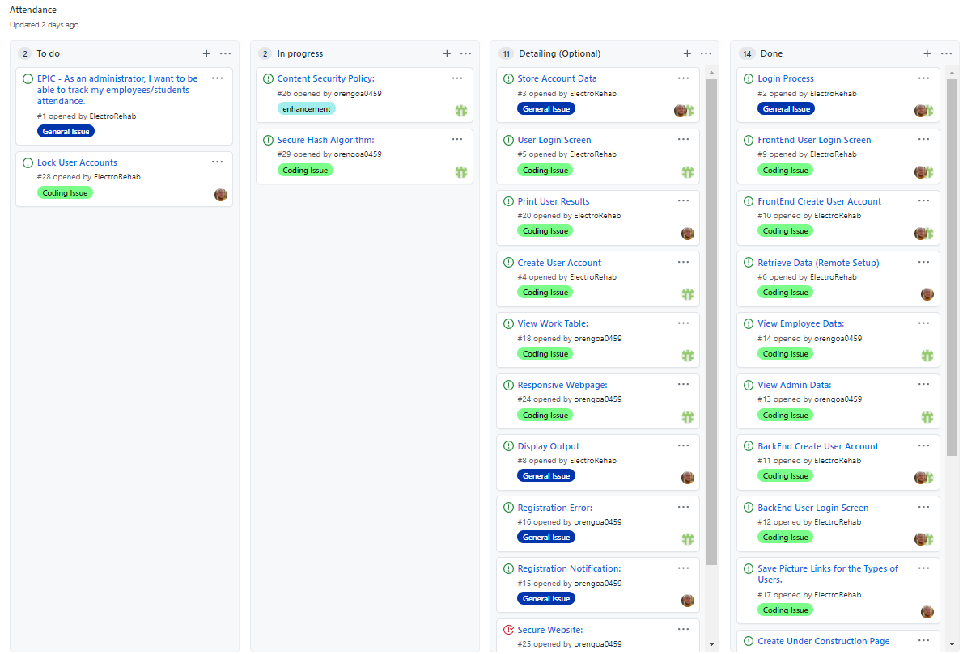
User Stories

Slide 10
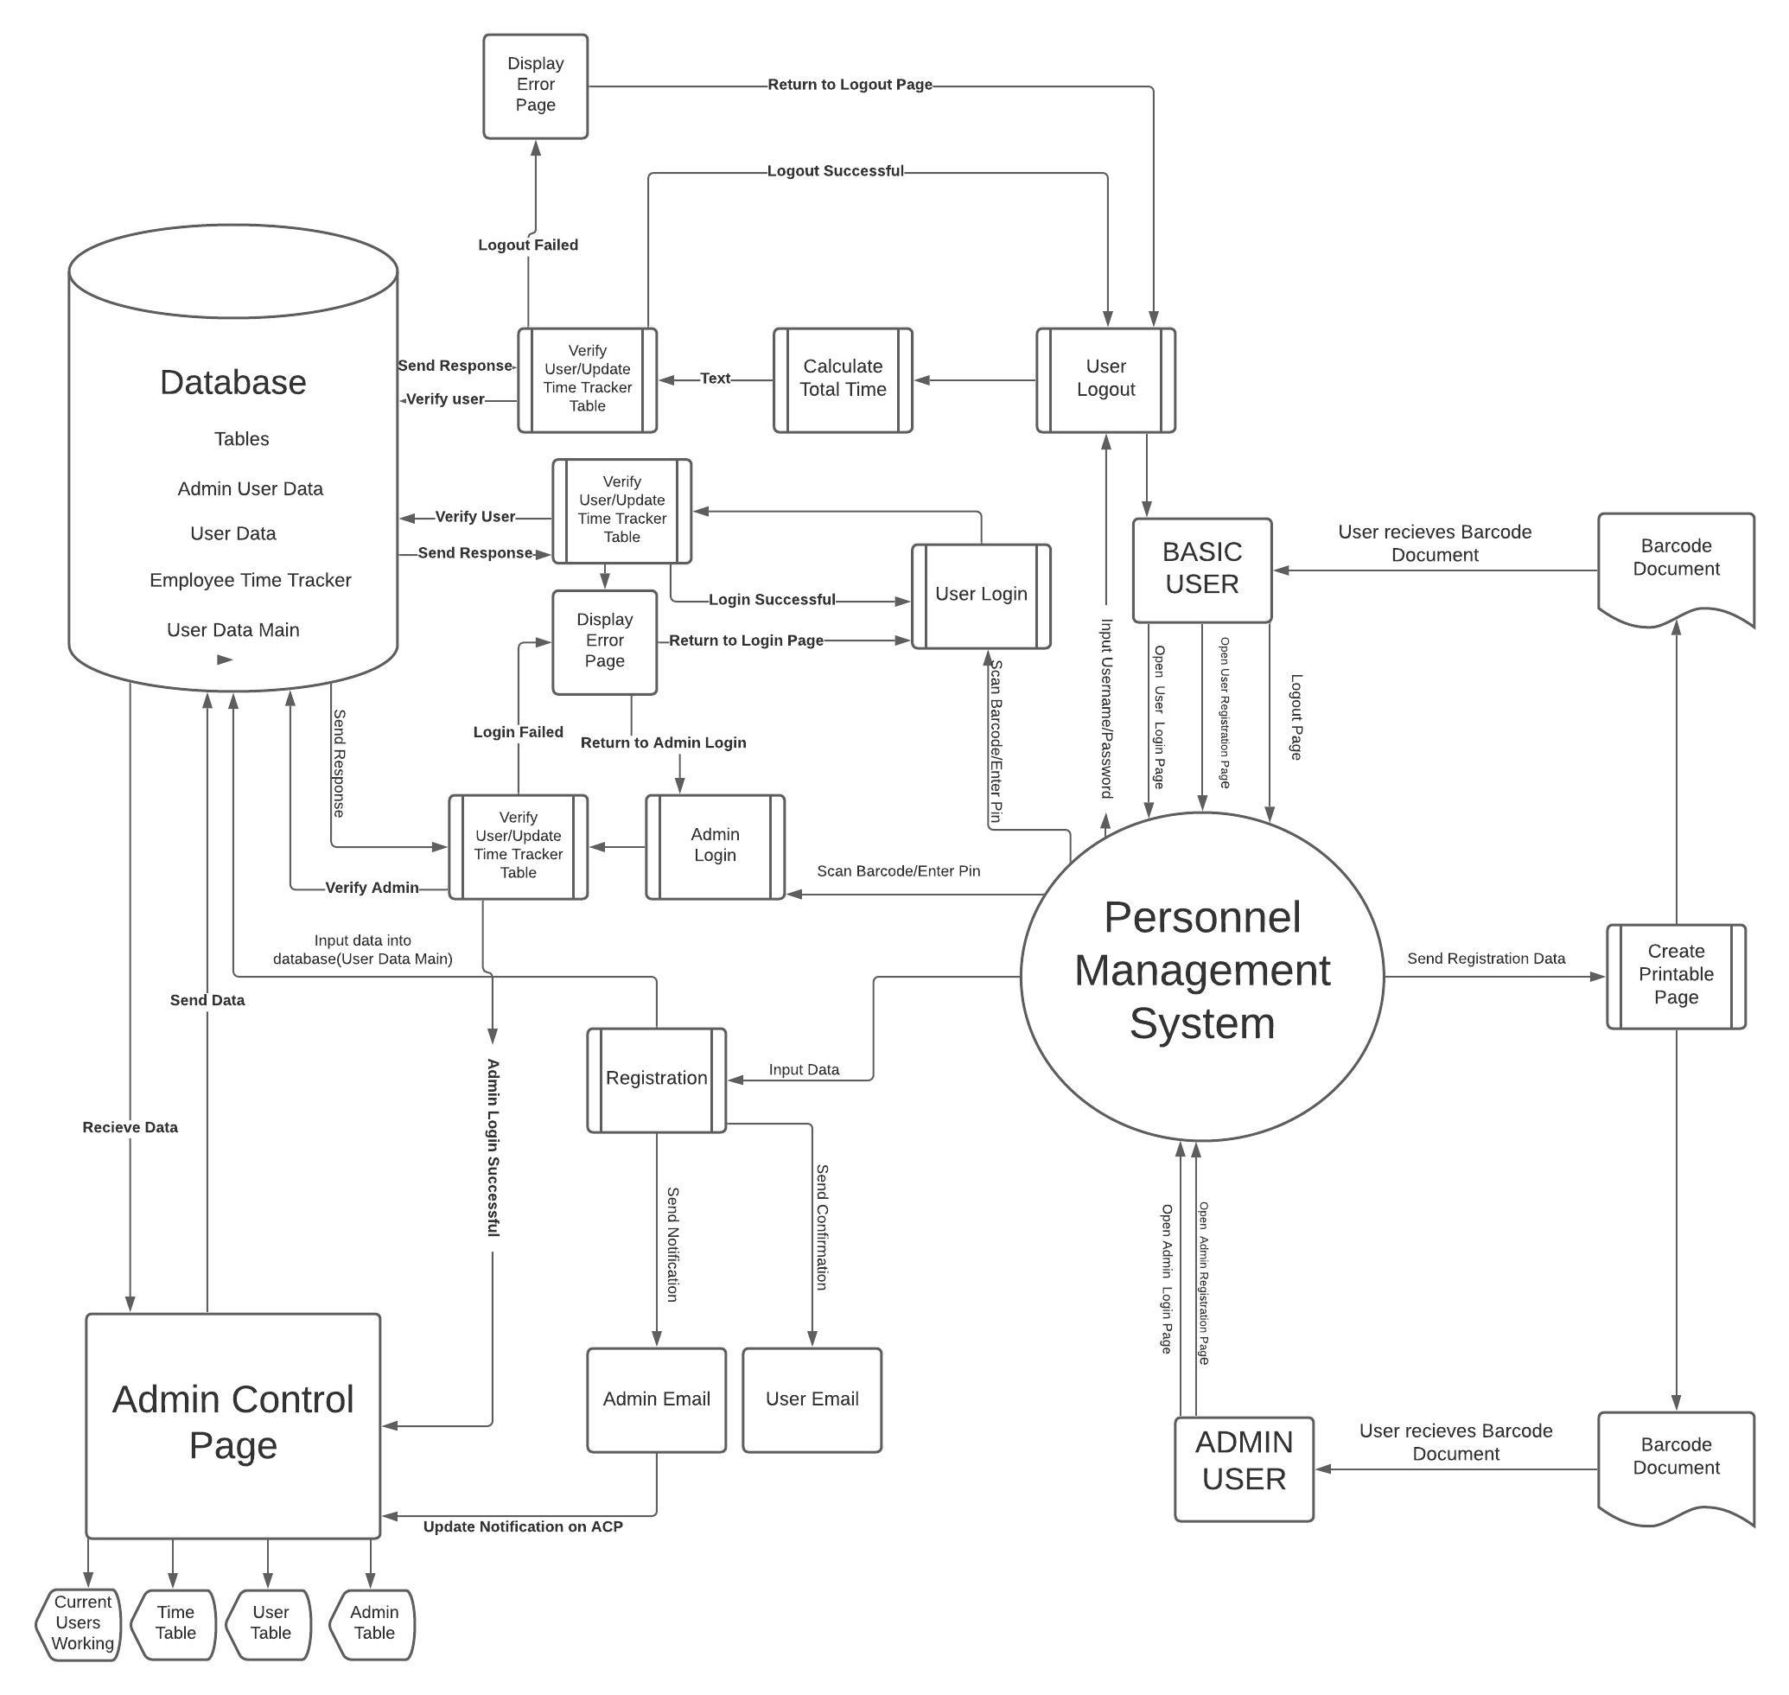
Context Diagram

Slide 11
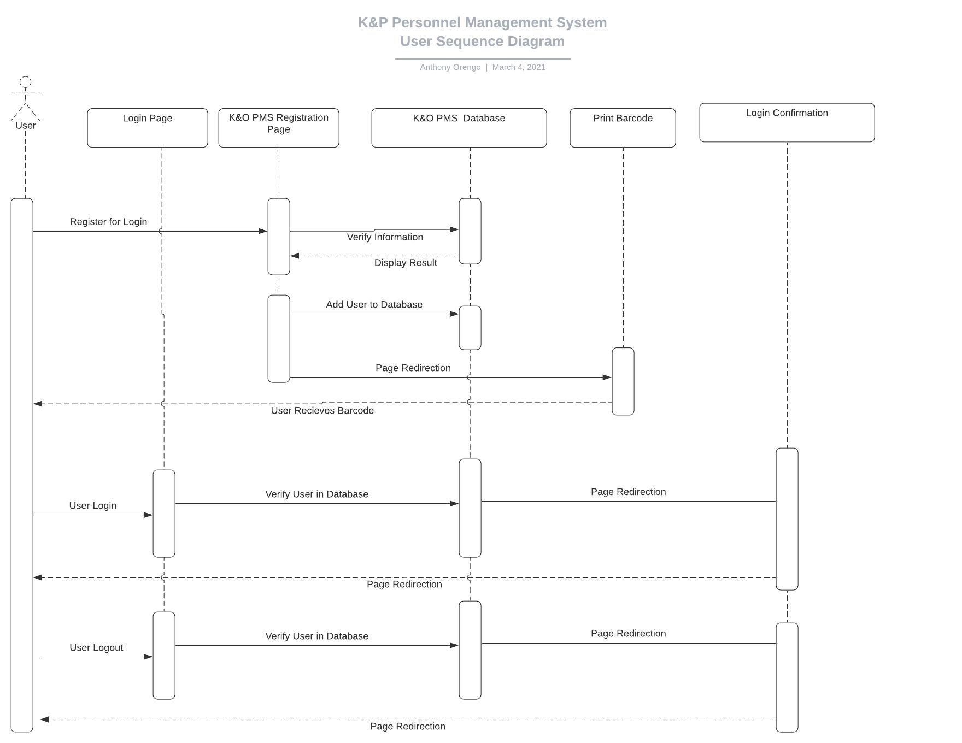
User Sequence Diagram

Slide 12
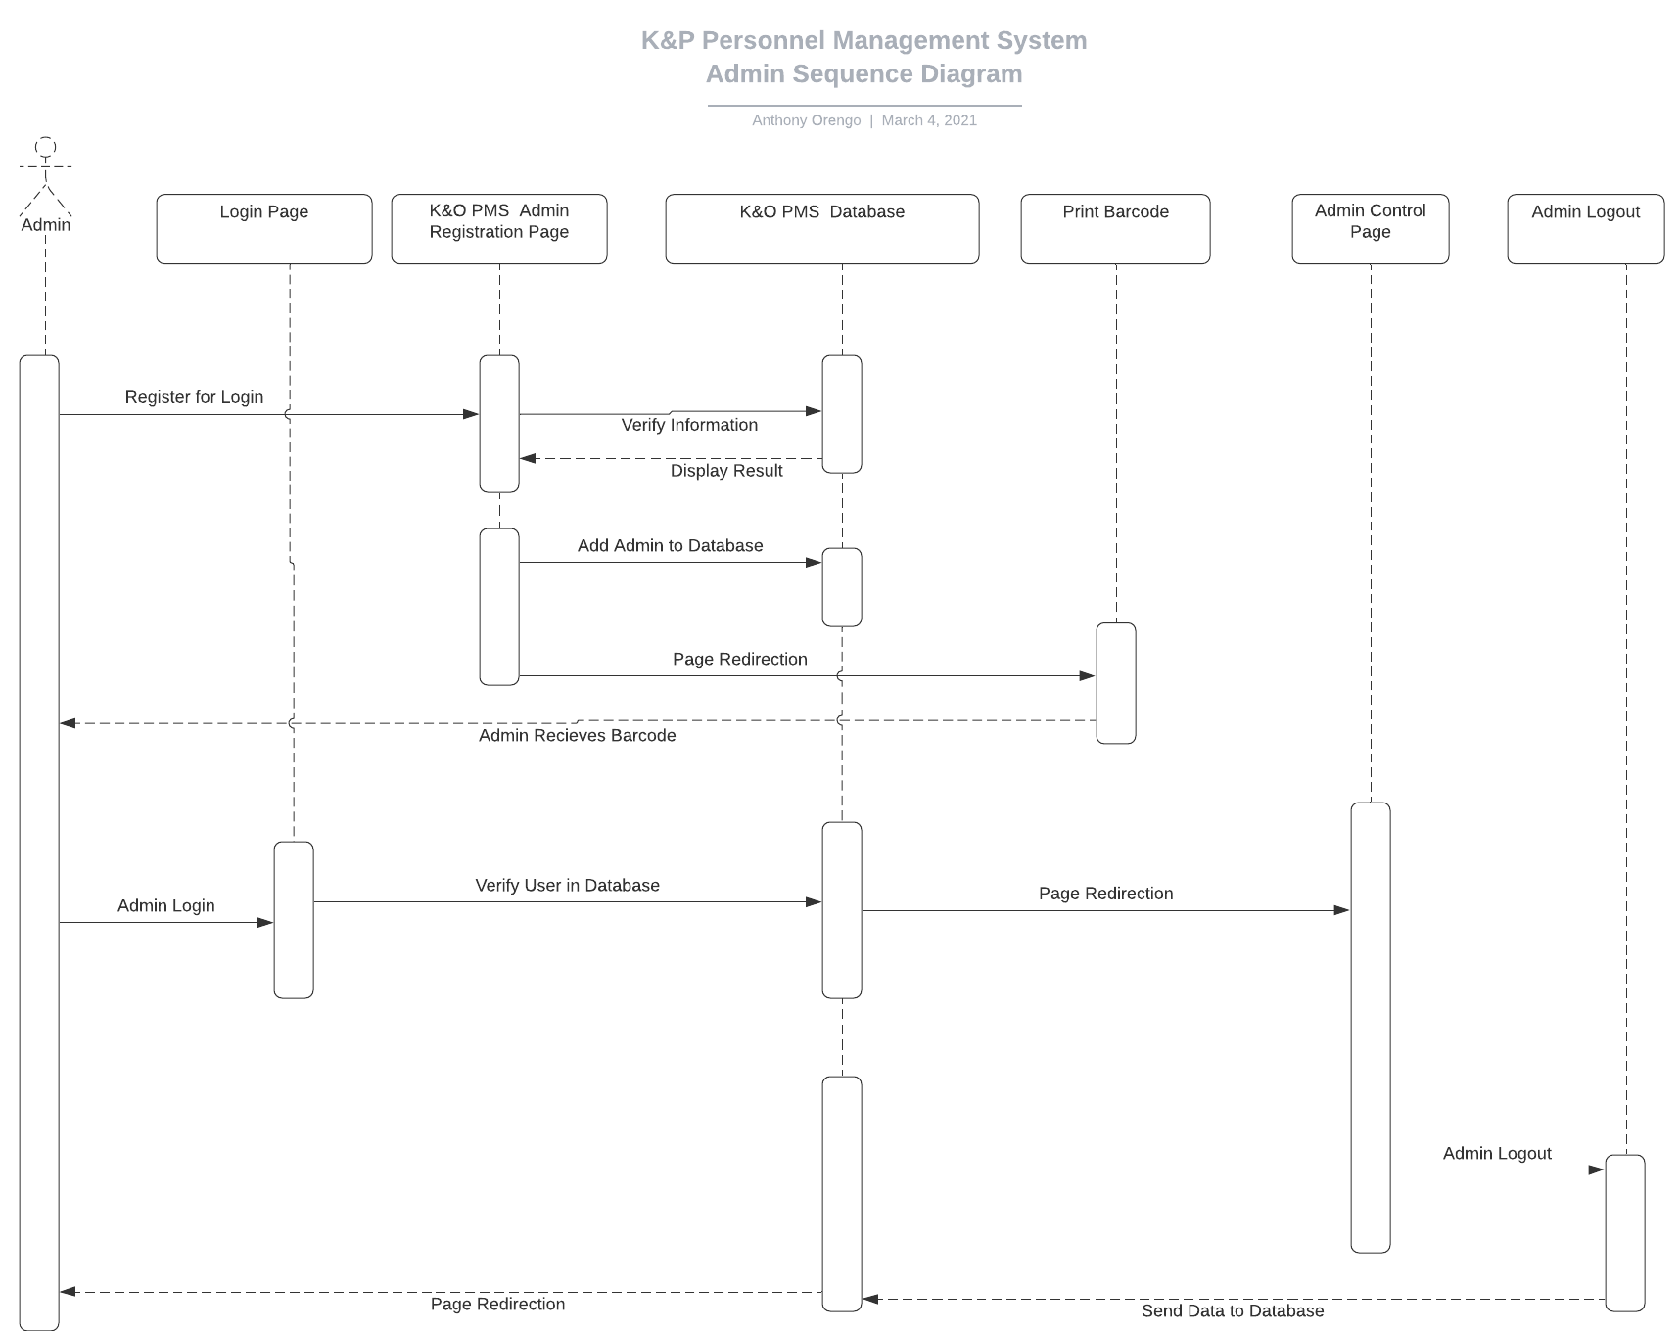
Admin Sequence Diagram

Slide 13

Application Security

Slide 14

Application Security
1. Security Methods
SQL Injection
HTTPS (SSL)
Content Security Policy(Cross-Site-Scripting)
DNSSEC Signing
SHA-2 512 bit(32byte) 128 Char Encryption
Defense In-Depth Strategies (Limit Access)

Slide 15

Live Demo

Slide 16
Questions?
Created by: Jon King, Anthony Orengo

